Slide 1
Logistic Regression

Slide 2
What is logistic regression?
Logistic regression is one of the most popular Machine Learning algorithms, which comes under the Supervised Learning technique.
It is used for predicting the categorical dependent variable using a given set of independent variables.

Slide 3
Observations
Evaluation:
The model was trained by using logistic regression algorithm.
It was found that the:

Slide 4
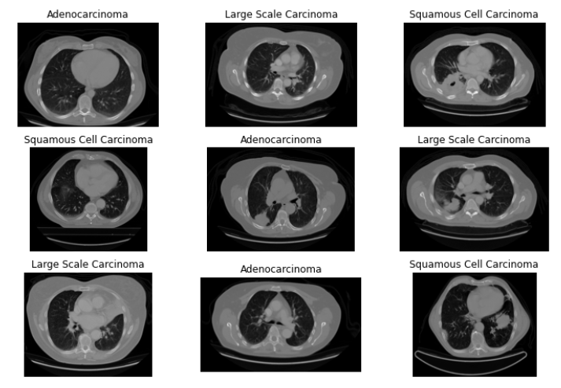
While predicting the lung cancer
adenocarcinoma, certain CT
Scans were fed into the model.
The outcome is as follows:

Slide 5
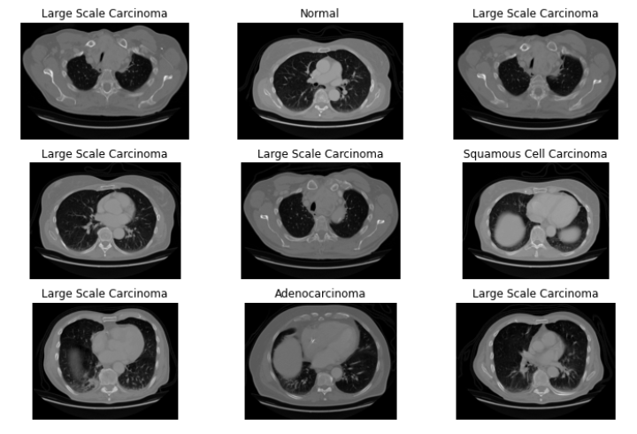
Results and Observations:
When the CT Scans containing
large cell carcinoma were fed
into the model, the results of the
prediction is shown alongside

Slide 6
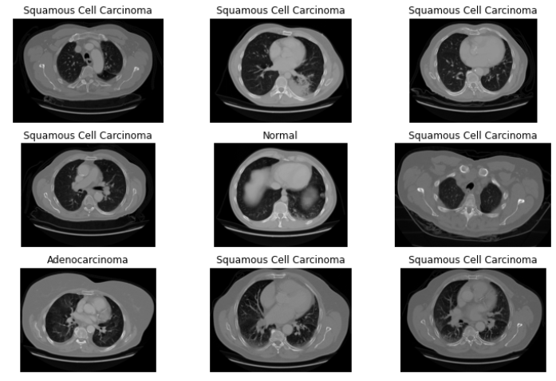
The model gave the prediction
when the squamous cell
carcinoma CT Scans were fed, as:

Slide 7
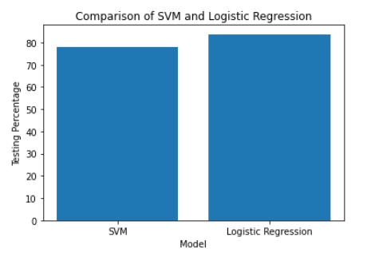
Comparison

Slide 8
Conclusion

